Slide 1
Turtlebot Followbot
Andrew, Sandesh, Prajacta, Dan
All Members of team have completed TRACE eval
Github Link: https://github.com/drewtu2/eece5698-final

Slide 2
Goals
Teleoperation
Generate map using SLAM
Navigate via python
Access and interpret Lidar Data
Detect target using LIDAR
Detect Person in Frame
Follow Person as they move
Sensor fusion w/ Lidar and Camera
Navigate to person using SLAM map
Notes:
Dan

Slide 3
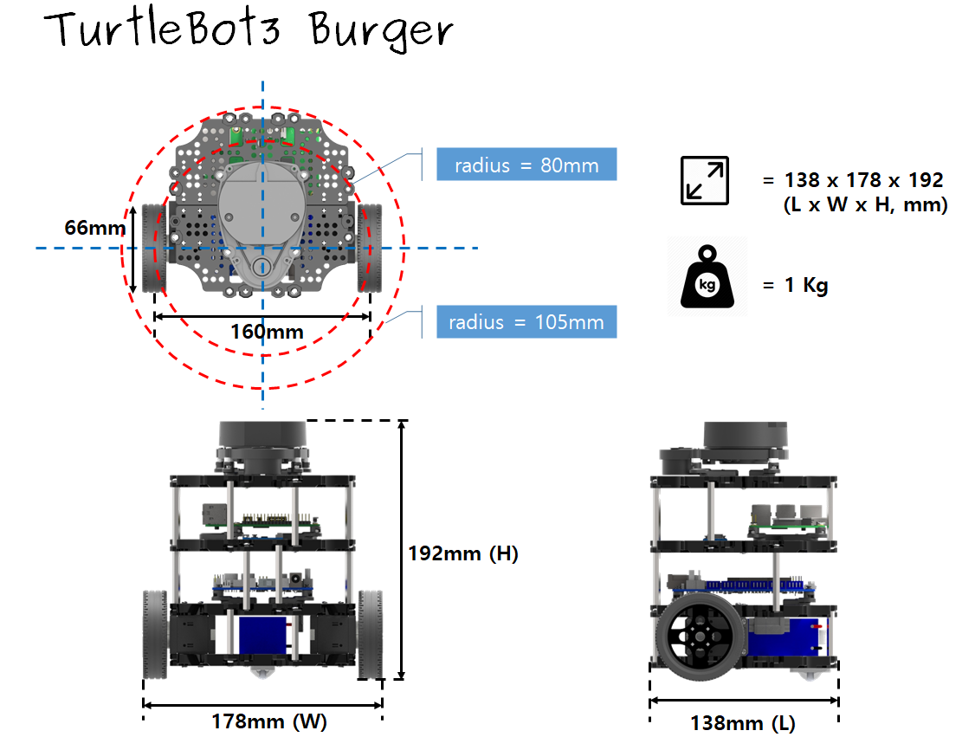
TurtleBot Burger
Specifications
SBC: Raspberry Pi 3 Model B
MCU: 32-bit ARM Cortex®-M7 with FPU (216 MHz, 462 DMIPS)
LDS: 360 Laser Distance Sensor LDS-01
IMU:
Gyroscope 3 Axis
Accelerometer 3 Axis
Magnetometer 3 Axis
Notes:
Sandesh

Slide 4
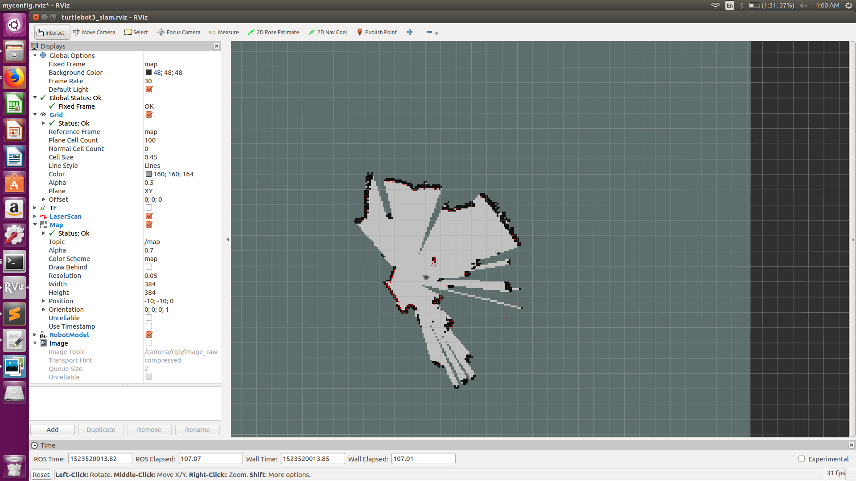
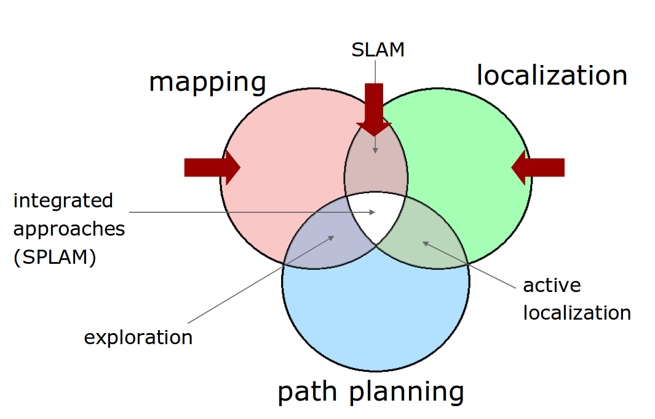
Gmapping - SLAM
-Estimates the MAP of environment and TRAJECTORY of a moving device.
-ROS uses Gmapping for SLAM which uses a particle filter to track the trajectories .
-GMapping is a highly efficient Rao-Blackwellized particle filter to learn grid maps from laser data.
Notes:
Prajacta

Slide 5
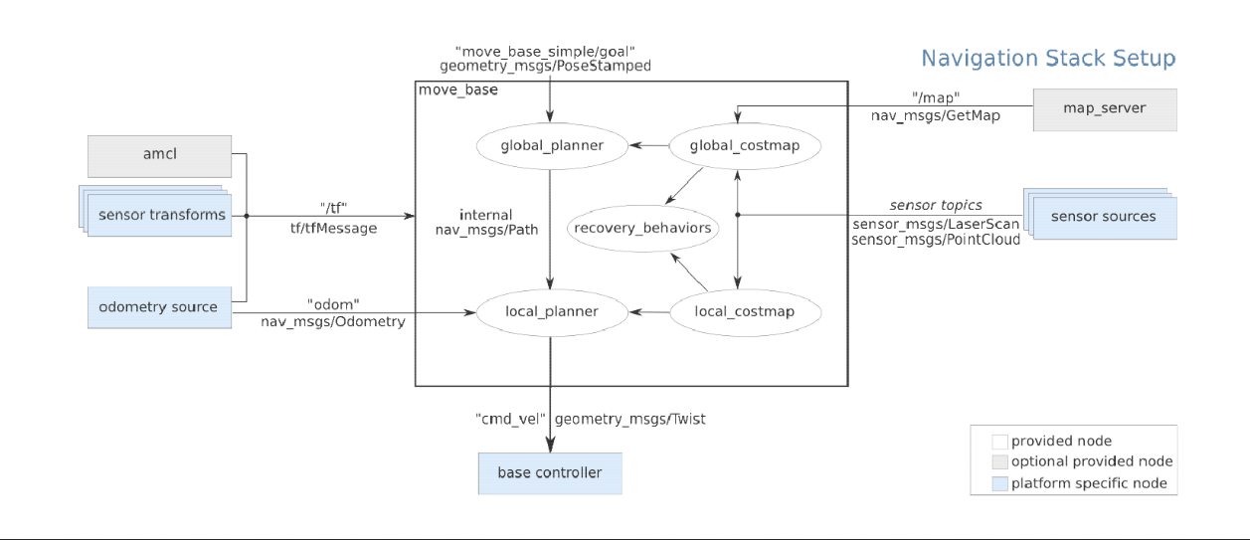
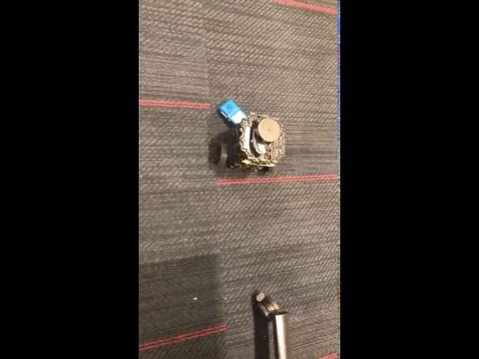
Navigation through Code
Notes:
Prajacta: Map provided by a “Map Server”
Each module is a node
Planner has a layered architecture (local and globa
l planner)
Obstacle sensing refined on-line by appropriate mod
ules (local
and global costmap)

Slide 6
-Calling an ACTION means calling a functionality that other node is providing.
-ACTION is asynchronous call to node functionality.
-Node providing functionality should contain action server.
-Node calling the functionality should contain action client.

Slide 7
LIDAR Detection and Tracking
Random forest Classifier for object/person detection
Robot recognizes and follows a person who is about 1 m away
Follow filter:
LaserScanAngularBoundsFilterInPlace: Removes points inside of a certain angular bounds. Currently removes 90 to 270 degrees.
LaserScanBoxFilter: Removes points in sensor_msgs/LaserScan inside of a cartesian box.
LaserScanRangeFilter: Removes measurements greater than upper threshold and less than lower threshold.
LaserScanIntensityFilter: Removes all measurements having intensity greater than upper and less than lower threshold.
Notes:
Sandesh

Slide 8
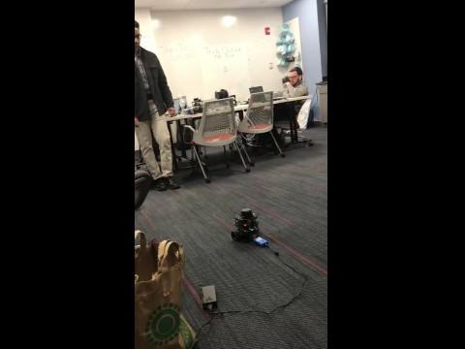
Video Demonstrations
Notes:
Dan

Slide 9
Image Processing Pipeline

Slide 10
Image Processing Pipeline Overview
Evaluated multiple methods of streaming -> Publish to image node
Raspicam Node
GStreamer + GScam
Perform object detection (Person detection)
HoG Detector
CNN Detector
Publish the largest region of interest to a ROI topic
From an ROI Node calculate transforms for image
Where does the center for the ROI fall with respect to the entire image? Rotate to bring the center of ROI into center of frame
If the ROI is in the center, drive forward toward the ROI

Slide 11
Image Processing Pipeline
Access Video Stream
Publish to ROS
Detect ROI
Drive Robot
Notes:
Andrew

Slide 12
Access Video Stream
Publish to ROS
Detect ROI
Drive Robot
gscam
dnn_detect_node
/raspicam2/image_raw
/roi
follow_node
hog_detect_node
republish
/cmd_vel
Key
raspicam_node
/raspicam_node/image
Node
/topic
Notes:
Andrew

Slide 13
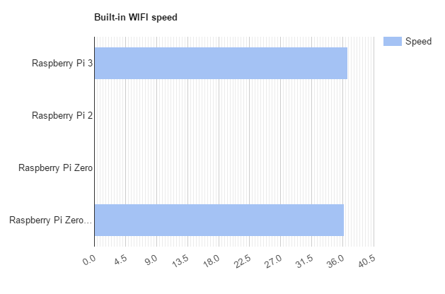
Access Video Stream
Publish to ROS
Detect ROI
Drive Robot
Severe latency Issues in playback
Wildly Inconsistent Results
Evaluated 2 methods of accessing video stream
Raspicam Node from Ubiquity
GStreamer + GScam
According to benchmarks, network throughput shouldn’t be a bottleneck: hypothesis is processing power of Pi.
Publish to /raspicam2/image_raw topic
Source: [1]
Notes:
[1]: http://www.notenoughtech.com/raspberry-pi/raspberry-pi-internet-speed/
Andrew

Slide 14
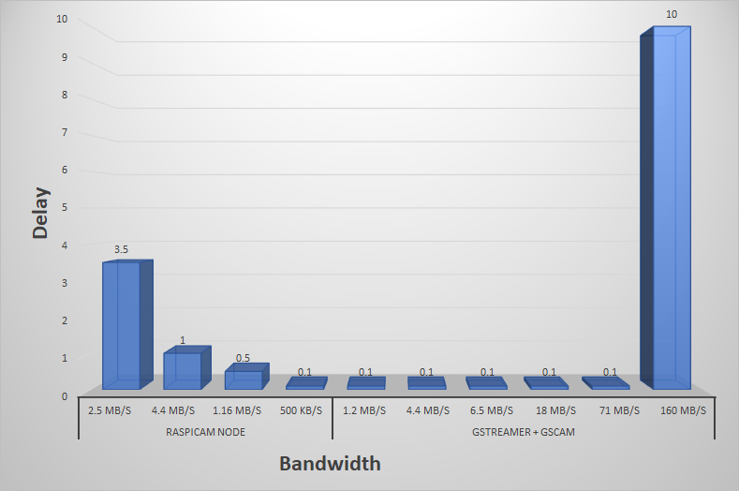
Delay at different expected bandwidths
Notes:
Andrew

Slide 15
Access Video Stream
Publish to ROS
Detect ROI
Drive Robot
Method | Resolution | FPS Pub | FPS Rec | Bandwidth | Delay
Raspicam Node | 640X320 | 30 | 3 | 2.5 MB/s | 3-4s
 | 320X180 | 18 | 18 | 4.4 MB/s | 1s
 | 320X180 | 5 | 5 | 1.16 MB/s | .5s
 | 128X72 | 18 | 18 | 500 KB/s | Real Time
GStreamer + GScam | 320X180 | 5 | 5 | 1.2 MB/s | Real Time
 | 320X180 | 18 | 18 | 4.4 MB/s | Real Time
 | 320X180 | 30 | 30 | 6.5 MB/s | Real Time
 | 640X180 | 30 | 30 | 18 MB/s | Real Time
 | 1280X640 | 30 | 30 | 71 MB/s | Real Time
 | 1280X720 | 60 | 60 | 160 MB/s | 10s
Notes:
Andrew

Slide 16
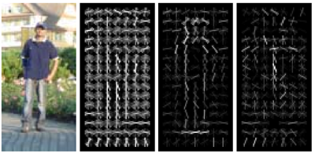
Access Video Stream
Publish to ROS
Detect ROI
Drive Robot
Histogram of Oriented Gradients (HOG) Detector w/ Linear SVM Classifier
OpenCV pre-trained model
Want to detect full body (or legs) rather than face
Better for pedestrian tracking than Viola-Jones Haar Cascades method
Still have issues with false negatives/positives given position
Future: Train our own classifier on only legs
Source [1]
Notes:
[1]: https://www.cc.gatech.edu/~hays/compvision/proj5/
[2]: HoG vs Haar: https://www.quora.com/Why-are-HOG-features-more-accurate-than-Haar-features-in-pedestrian-detection
HoG: Shape, outline detection
Vs
Haar: Texture/Shading detection

Slide 17
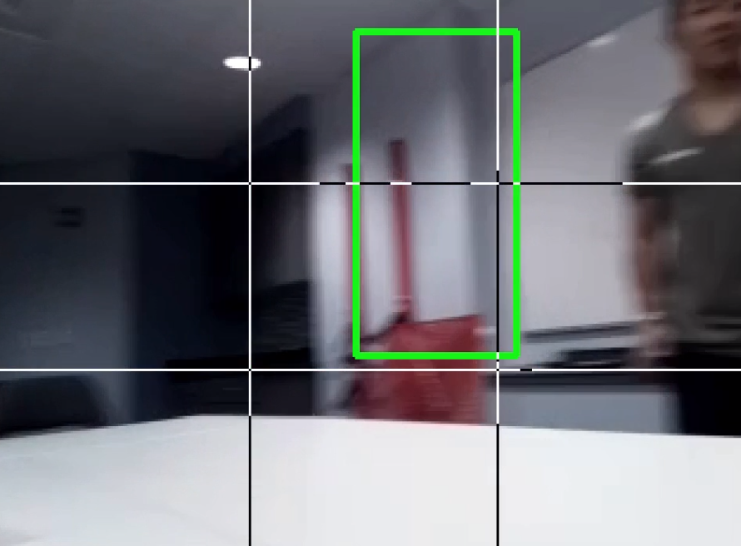
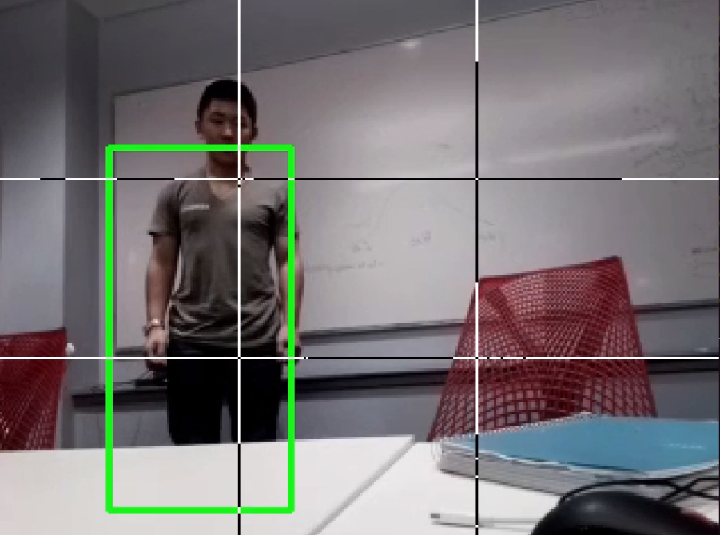
Access Video Stream
Publish to ROS
Detect ROI
Drive Robot
Left: False Positive Right: Detection
Notes:
[1]: https://www.cc.gatech.edu/~hays/compvision/proj5/
[2]: HoG vs Haar: https://www.quora.com/Why-are-HOG-features-more-accurate-than-Haar-features-in-pedestrian-detection
HoG: Shape, outline detection
Vs
Haar: Texture/Shading detection

Slide 18
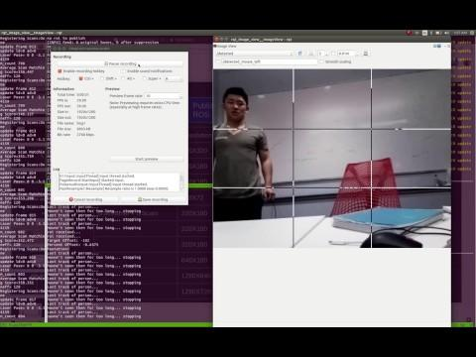
HoG Run
Notes:
Dan

Slide 19
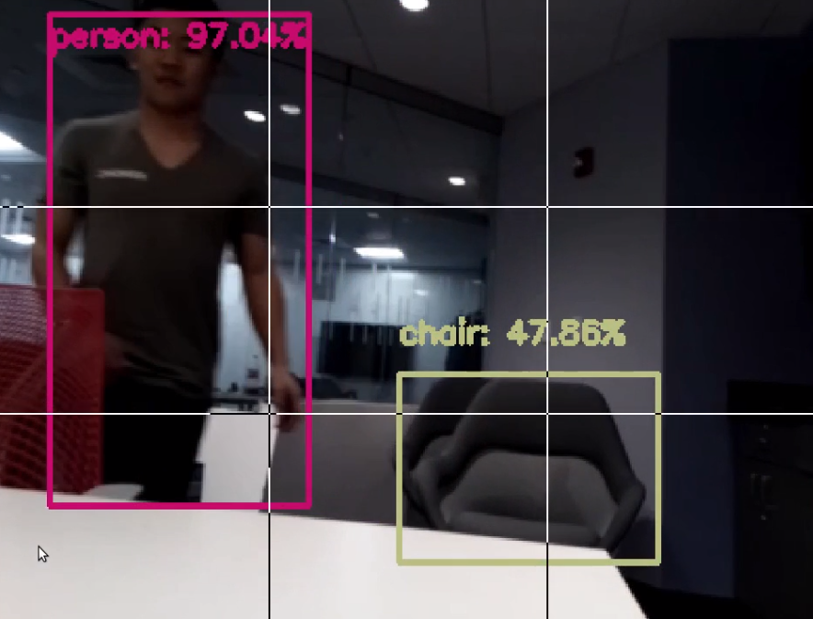
Access Video Stream
Publish to ROS
Detect ROI
Drive Robot
Caffe implementation of Google MobileNet SSD
OpenCV Pre-Trained model
Can detect more than just people
CNN
OpenCv has framework for other nets including
MobileNet-SSD, Caffe
OpenCV face detector
SSDs from TensorFlow
YOLO
VGG16-SSD
Faster-RCNN
R-FCN
Notes:
[1]: https://www.cc.gatech.edu/~hays/compvision/proj5/

Slide 20
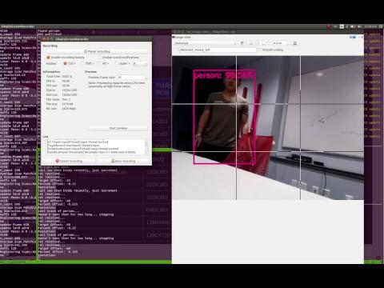
MobileNet SSD
Notes:
Prajacta

Slide 21
Access Video Stream
Publish to ROS
Detect ROI
Drive Robot
Calculate Center of Region of interest ( w/ respect to image)
Rotate to center ROI in frame - scaled based on distance away from center
Drive forward at centered ROI
Notes:
[1]: https://www.cc.gatech.edu/~hays/compvision/proj5/

Slide 22
Future Work
Enable smooth navigation of robot during turns
Improve image latency and consistency
Distance estimation and obstacle avoidance by:
Sensor Fusion (LIDAR + CAMERA)
Replacing current camera with Google Tango which has range detection
Notes:
Sandesh

Slide 23
Questions
All Members of team have completed TRACE eval
Github Link: https://github.com/drewtu2/eece5698-final

